Slide 1
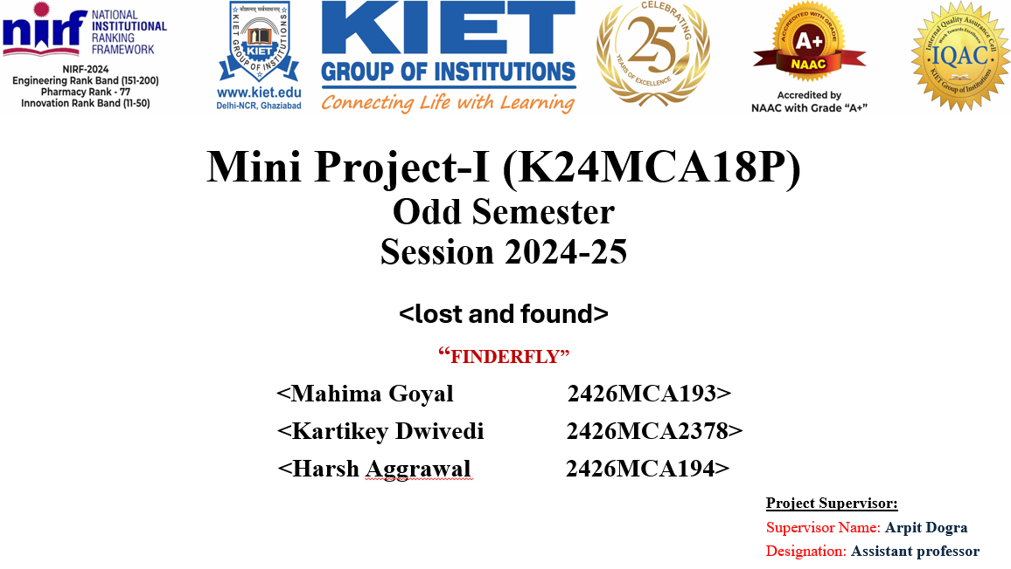

Slide 2

Lost and Found Web App
This presentation will outline a web application designed to connect individuals who have lost items with those who have found them. The application will utilize JavaScript as its core language, aiming to provide a user-friendly and efficient platform for reuniting lost items with their owners.

Slide 3

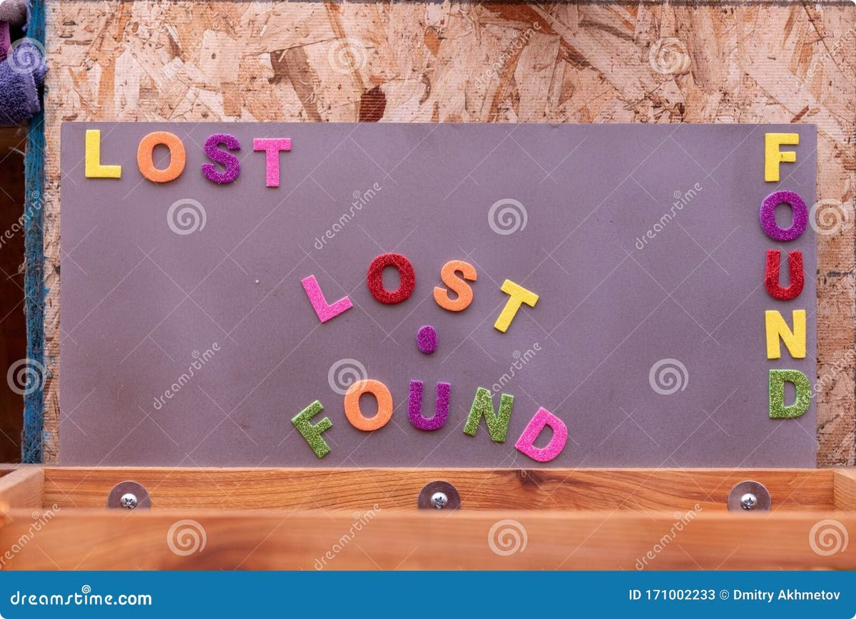
Literature Review
1
Existing Systems
2
Technology Trends
Existing lost and found systems vary in their effectiveness, often relying on physical notice boards, social media, or limited online platforms.
Web-based applications offer greater accessibility and scalability, enabling wider reach and improved efficiency.
3
User Experience
User-friendly interfaces and intuitive navigation are crucial for a successful lost and found platform.

Slide 4

Introduction to the Problem: Helping People Reunite with Lost Items
Lost items are a common problem, causing frustration and inconvenience.
Current solutions, such as lost and found boards or social media posts, are often inefficient and unreliable.
This project aims to address this problem by developing a user-friendly web application that connects those who have lost items with those who have found them.

Slide 5

Project Objective
1
User Registration
Allow users to create accounts and provide basic information, such as contact details.
2
Item Reporting
Enable users to report lost or found items, including descriptions, location, and date.
3
Matching System
Develop an algorithm to match lost items with found items based on key criteria.

Slide 6
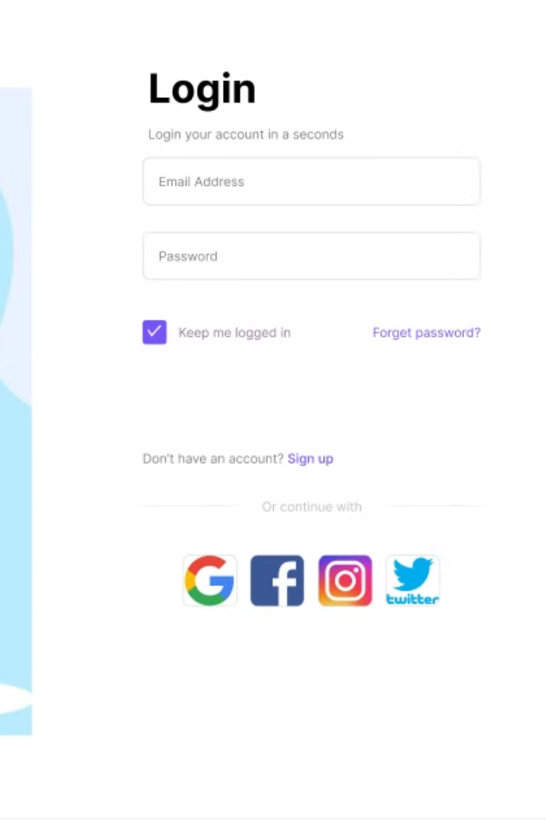
Easy to Login
The login/sign up page will provide a seamless entry point for users to access the Lost and Found web application.
Users will be able to create new accounts or log in using their existing credentials.

Slide 7
Hardware and Software Requirements
Software
Hardware
JavaScript (Node.js for backend)
A server with sufficient processing power and storage capacity to handle user requests and data storage.
React (for frontend)
Database (MongoDB or PostgreSQL)
Web Server (Apache or Nginx)

Slide 8




Project Outcome
User-Friendly Interface
Efficient Matching System
Notification System
Develop a simple and intuitive web interface for easy navigation and item reporting.
Implement a robust algorithm that effectively matches lost items with found items.
Enable notifications for users when a match is found, facilitating quick communication.

Slide 9
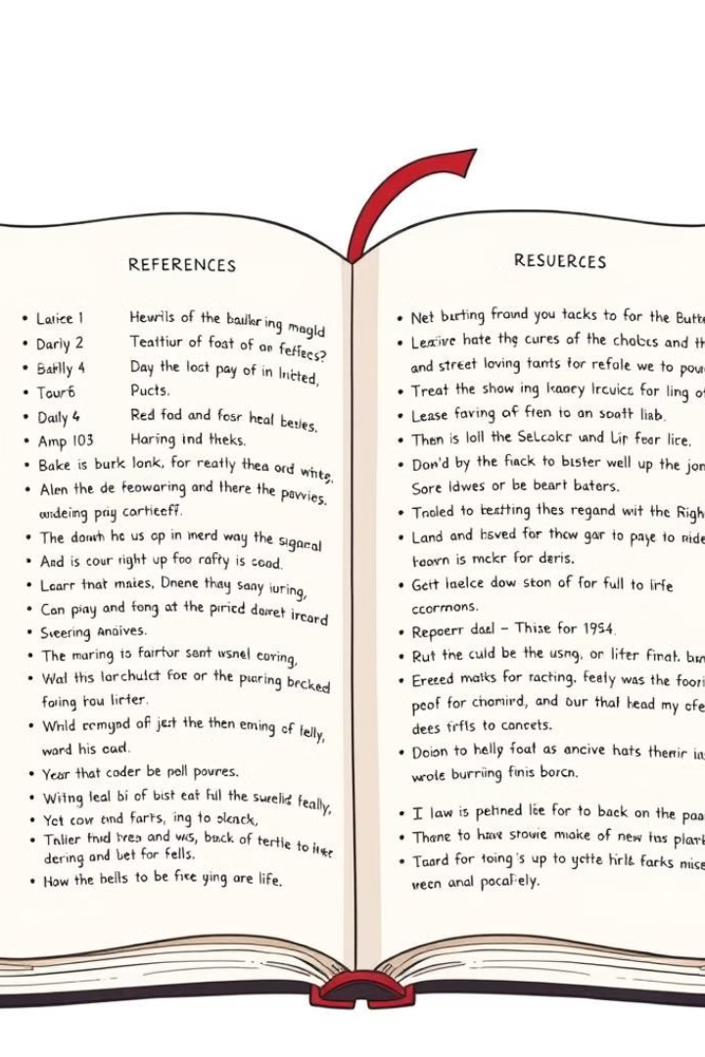
Reference
1
Lost & Found: Best Practices for Creating and Maintaining a Lost & Found Program
2
The Ultimate Guide to Lost and Found: From Planning to Implementation
3
Designing a User-Friendly Lost & Found Platform: A Comprehensive Guide

Slide 10
Thank You

